Slide 1
FEEDBACK:
Sensitivity / specificity as a metric (over-, undersegm.)
No simpler method
Take more training samples on less training images
Add one slide on clinical problem
More numbers for images in presentation (stats etc.)
Reasoning / interpretation very good
Plot feature importance (numbers / bars)
More insight in the situation (training-, testing-setup)
Compare testing-time
Segmentation of brain tissues
Midterm Presentation MIALab
Matthias Fontanellaz, Michel Hayoz, Jonas Ledergerber
07.11.2018, ISTB Uni Bern
Notes:
1

Slide 2
Content
Approach
Progress
Challenges
Insights
Outlook
07.11.2018
Segmentation of brain tissues
2
Notes:
2

Slide 3
Approach
Evaluate different methods for segmentation:
Random forest, Logistic regression, SVM linear, SVM rbf
Approach:
Polynomial features (x^2, y^2, … , xz)
Parameter tuning (GridSearch for C and Gamma)
Balance of training examples per class
Feature scaling
07.11.2018
Segmentation of brain tissues
3
Notes:
Logistic regression, SVM linear, SVM rbf (radial basis function kernel): compare how they do with respect to the existing random forest in the pipeline (what’s the potential if we finetune the methods and what parameters and changes lead to what outcome?)
Importances of features for the different methods and gaining an understanding how changes effect the segmentation.
Approaches:
7 original features + polynomial features (position -> x^2, xy, xz, yz, y^2, z^2) mapping the input into high-dimensional feature spaces to perform non-linear classification
Parameter tuning (GridSearch for C where applicable)
Balance of training examples per class (smaller structures are relatively more taken into account)
Feature scaling
3

Slide 4
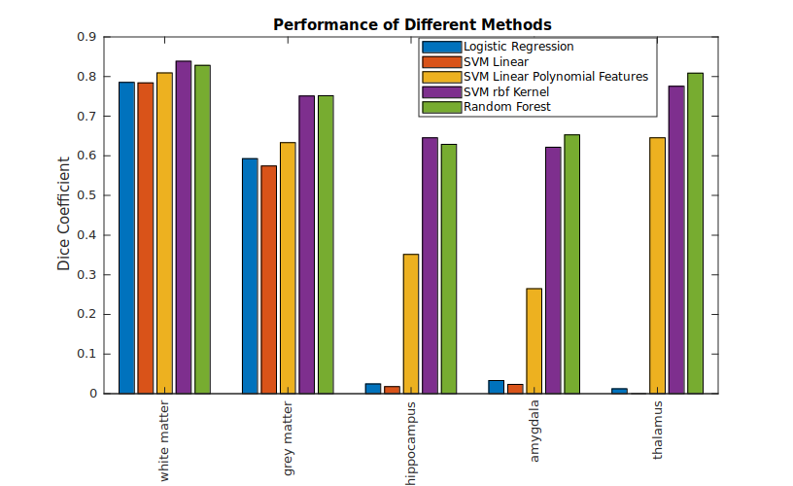
Progress
07.11.2018
Segmentation of brain tissues
4

Slide 5
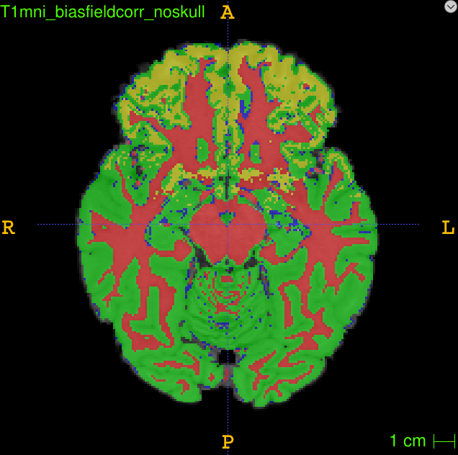
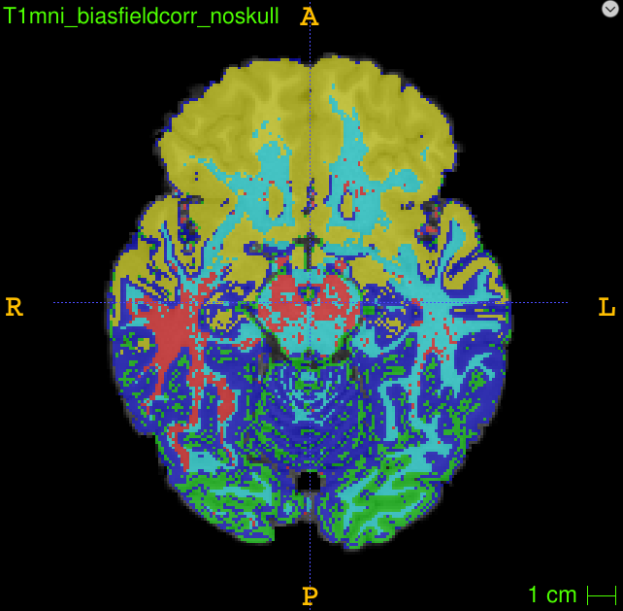
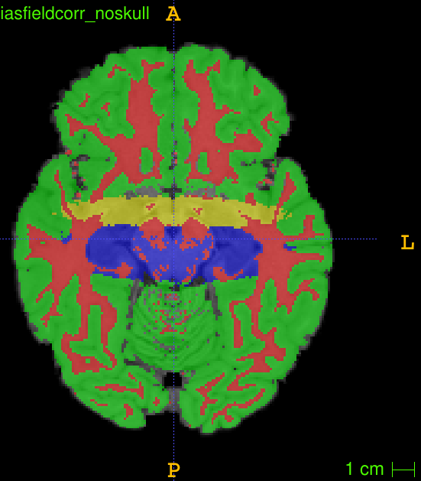
Insights SVM (linear)
Same features as RF
→ intensity feature
Balanced samples
→ intensity feature
→ small structures important
Second order coordinates
→ position feature important
→ complex boundaries require high order terms
07.11.2018
Segmentation of brain tissues
5

Slide 6
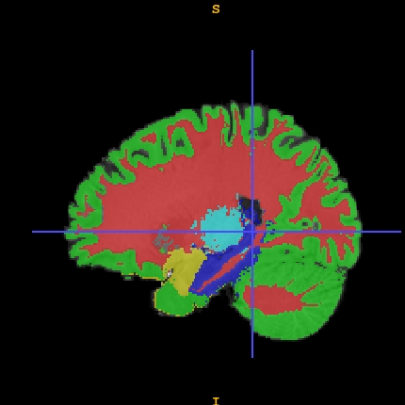
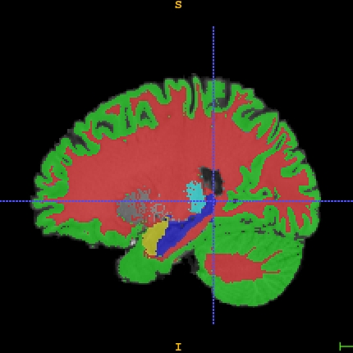
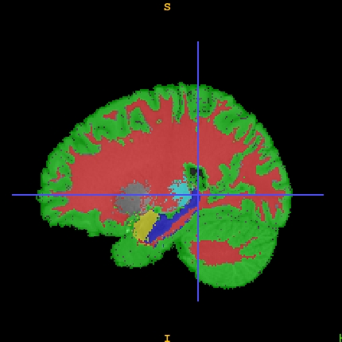
Insights SVM (rbf)
C=5, G=0.3
Oversegmentation of small structures
Random Forest
Reference
C=15, G=10
Undersegmentation of small structures
07.11.2018
Segmentation of brain tissues
6

Slide 7
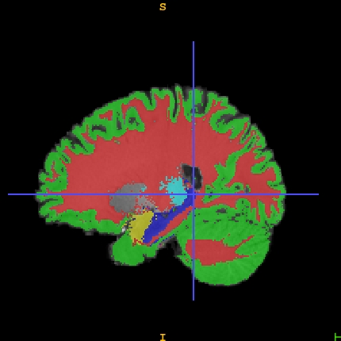
Insights SVM (rbf)
Random Forest
Reference
C=15, G=5
07.11.2018
Segmentation of brain tissues
7

Slide 8
Outlook
Compare results with simple segmentation methods
Use another evaluation metric
Evaluate on full test set
Parameter tuning
07.11.2018
Segmentation of brain tissues
8

